Slide 2
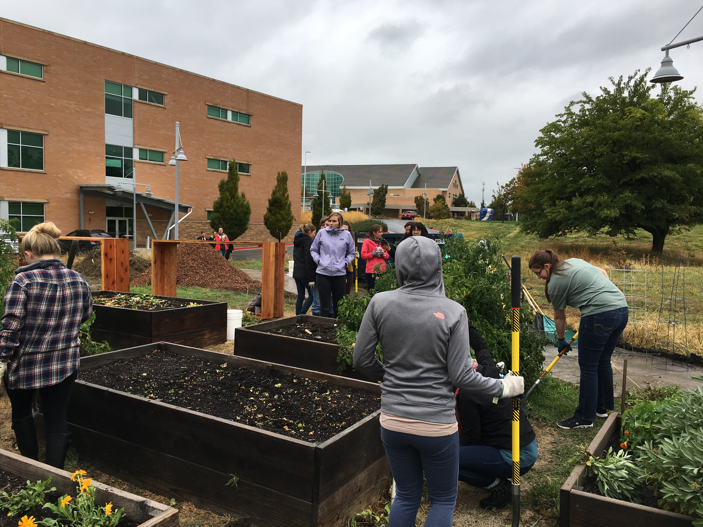
Goals & Accomplishments

Slide 3
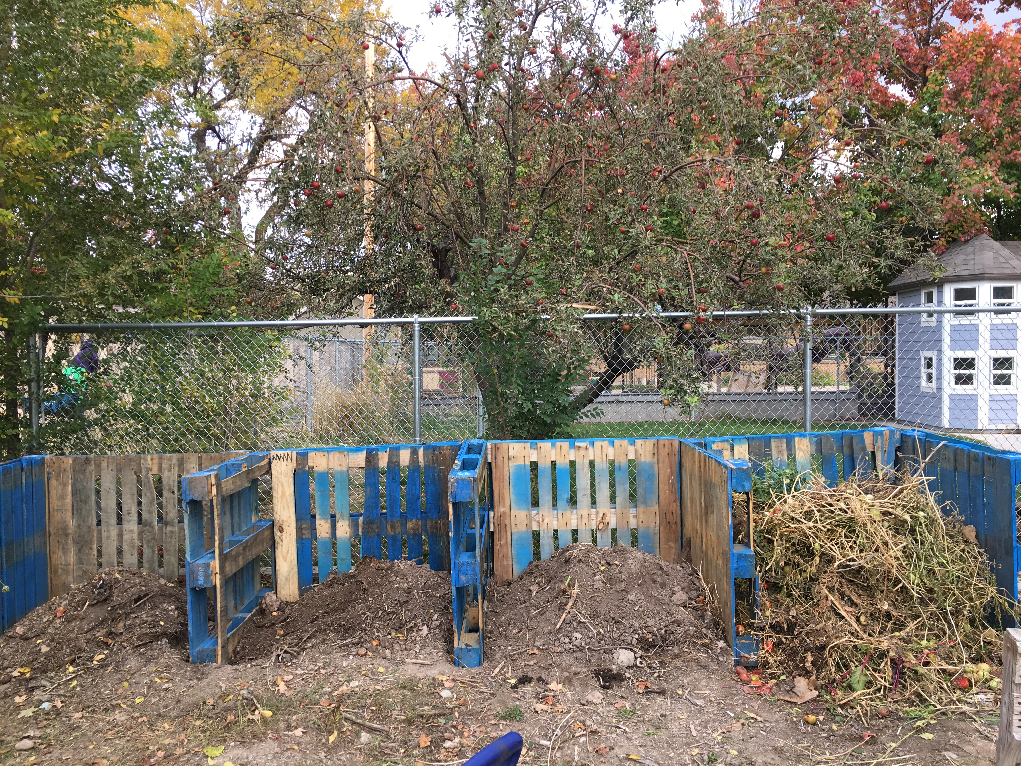
Goals & Accomplishments

Slide 4
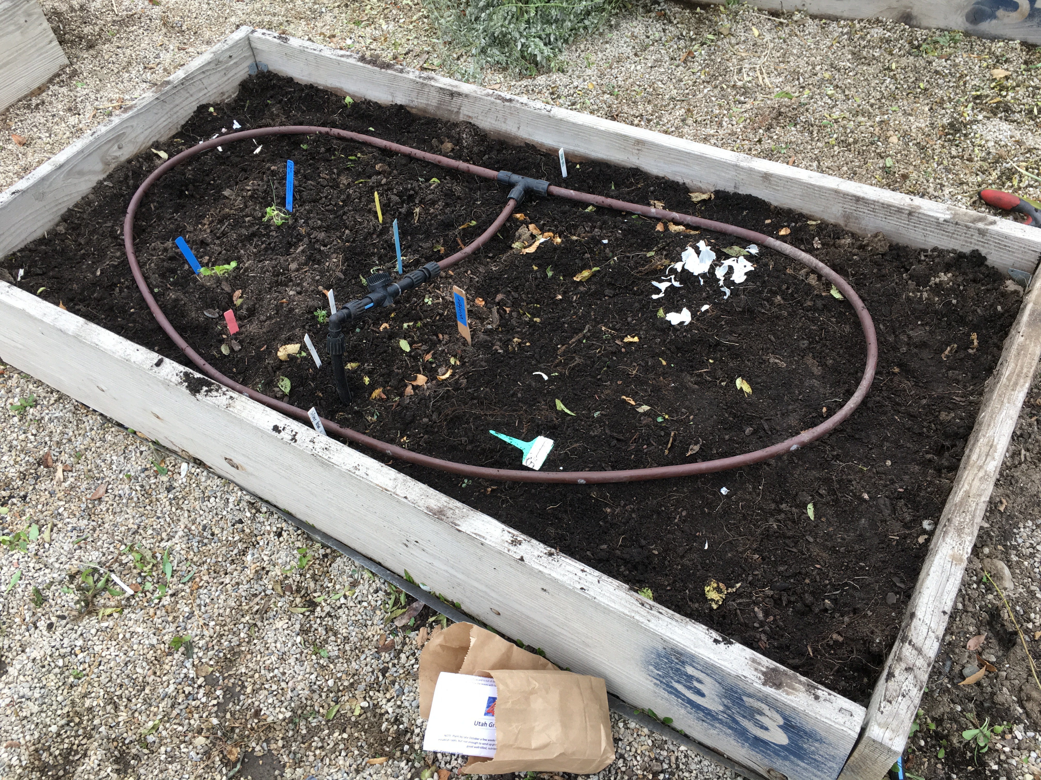
Goals & Accomplishments

Slide 5
Problems with almost every…

Slide 6
Three Simple Rules
Show up when you say you will
Communicate project progress and when you’re running late
Follow directions & do your work
plenty of more complex asks…

Slide 7
Exhibit A:
Website Redesign
https://www.slccgardens.com

Slide 8
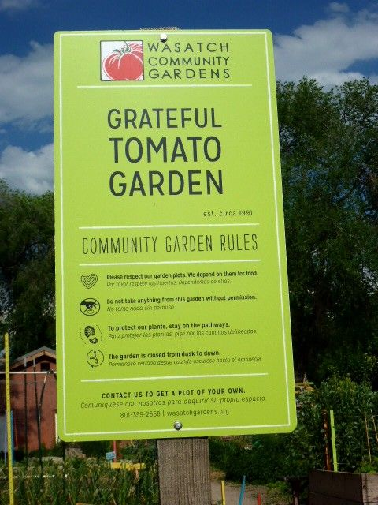
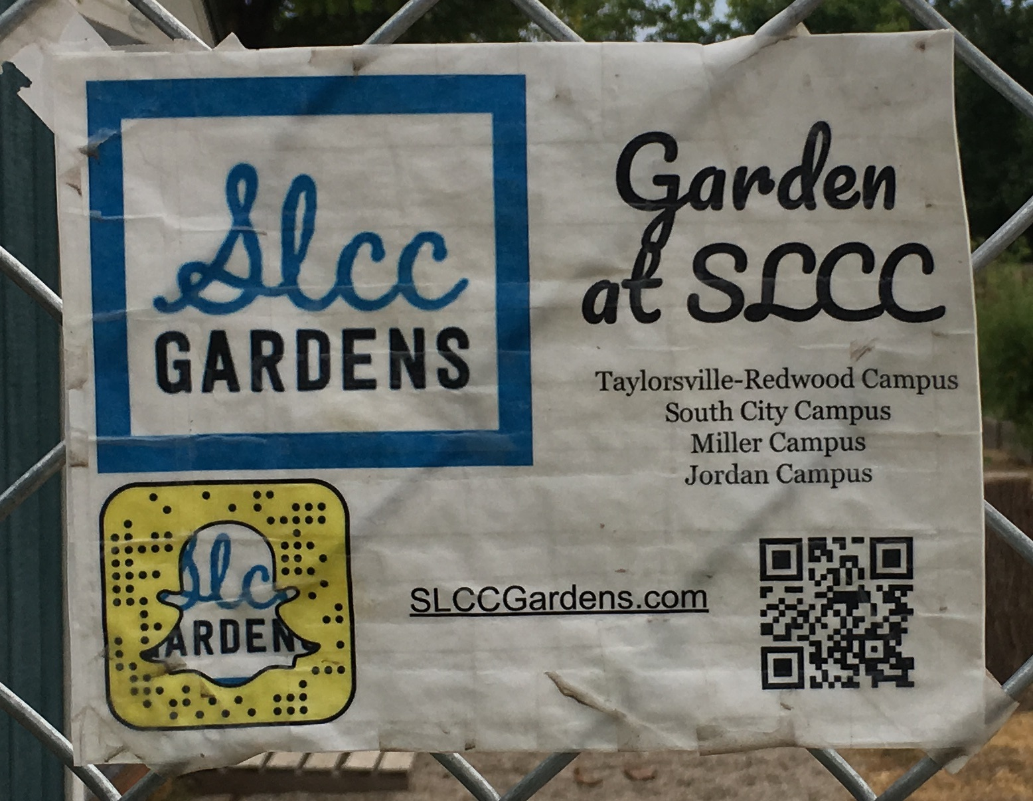
Exhibit B: Sign Project

Slide 9
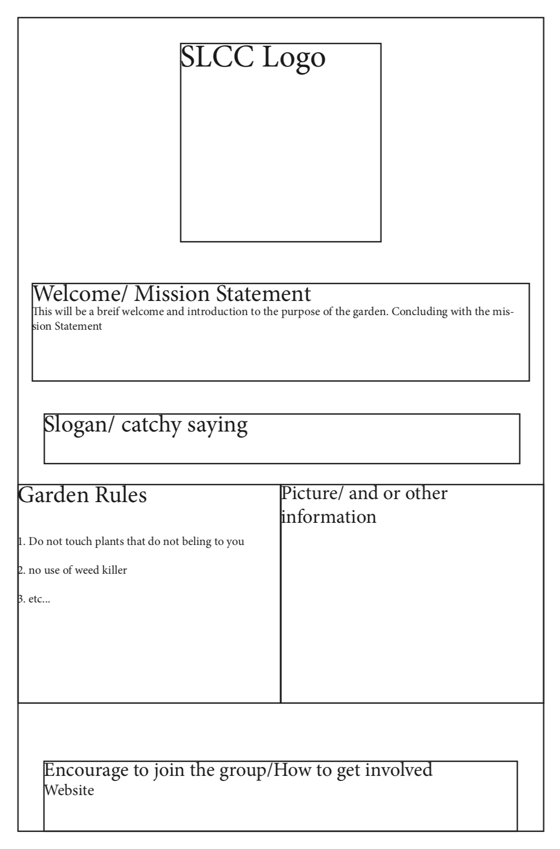

Slide 10
Hi Garrett,
Thank you for sending me these. Overall, I like your ideas and think you and your team are moving in the right direction.
I left detailed feedback below. “Sign 1” looks pretty good, but I left a lot of feedback anyway. Don’t be overwhelmed by all this; these are mainly ideas to consider and my thoughts. “Sign 2” needs more changes, but it will ultimately end up being a lot less work than what you were thinking of doing.
My comments are ultimately just suggestions. For any part of this project, if you think I am wrong and that your way is better, you should tell me so and why you feel that way. I am by no means an expert on this and do not know the best way to design these signs, so I appreciate any of your thoughts and feedback.
Sign 1:
The first sign you see is the one that will be placed on the actual garden. Yes
We feel a welcome message would be good, or maybe having a big welcome at or near the top of the sign would be good. Additionally, having the mission statement, or purpose of the garden would be good information to have listed. Yes, I like this idea. We could say something like “Welcome to our garden. Our mission is too…” at the beginning. Here are a few links with mission statements:
Our website: https://www.slccgardens.com/about
SLCCSync: https://orgsync.com/149792/chapter (in a couple places)
And:
The Thayne Center for Service & Learning provides a supportive and inclusive office for students to explore community involvement, leadership, and volunteerism. By providing opportunities in conjunction with local nonprofits we cultivate an environment to test our student’s interests and area of study while assisting them to realize they have the knowledge and skills to affect positive change in our community.
The campus gardens are here to provide food for those in need, to teach people how to grow their own food and about issues surrounding food, and to create a community around a common interest and bring members of the college together in a different and more relaxing setting. We strive to make fresh, healthy food more accessible to members of the college, but also to allow the gardens to accomplish something even greater for the community.
If there is a slogan or a catch phrase associated with the gardens that could also be a possibility to have on the sign. I don’t think we have anything like this, but you could come up with something if you’d like. Or maybe this could be mixed into the mission statement somehow.
We also think it would be good to have actual rules posted on the sign to allow individuals what they can or can not do in the garden. Possibly, but this is tricky. There’s a handful of rules for plot renters pertaining to their use of the garden and about maintaining their plot, but not many for visitors or volunteers. This is something I’m working on revamping. Right now, I’d say the general rules are no pets, don’t brake things, don’t pick any produce that doesn’t belong to you, and you are liable for your own actions. Maybe you could have some symbols like the no pets symbol, but this is up to your team to decide what’s best. We should be careful not to clutter the sign with too much information, especially if some of it is obvious. But it looks like the Grateful Tomato sign for has some good rules.
At the bottom of the sign would be the how to become involved information. Yes.
I think the layout of this sign is good! We’ll just have to see how much space everything takes up.
A few important items that were not mentioned: name of the garden, list of other gardens (perhaps with some space if/when we add future gardens). Year established could be nice to add, but not 100% necessary. See what you think.
Nice job including the SLCC logo. The SLCC Gardens logo: https://documents.maxcorwin.com/slcc/logo.png is another one that should be included.
If you want other photos, here are a whole bunch: https://drive.google.com/drive/folders/1U-8x1bbPrlB5wERYwvAXBu_IQx_b2xCRmk-w-Oo9ykY?usp=sharing. However, we will have to see how appropriate these are for this sign.
Remember that Miller’s garden is a little different, mainly in that it is only for the culinary program. They also do not have box plots.
Sign 2:
The second sign is going to be designed to be placed throughout the campus. Not necessary “throughout” campus, but one or two near each garden pointing people towards it.
This sign will focus mostly on educating students about the gardens, and to locate them. One of the challenges associated with the campus gardens is how to direct individuals to its location. Yes. This is a challenge. It’s very hard to explain how to get there on this campus.
We feel a good option would be posting a map of the SLCC campus with the gardens marked on it. That way no matter where the sign is posted, students will be able to figure out where it is located. While I think this could be a good idea for fliers that we hand out, I am not sure that it is appropriate for this kind of sign. It would be strange to have campus maps already around campus and then to also have more maps just showing where the garden is. When they next update the campus maps that are around campus, we would like to have them add the garden. These signs will be near the gardens, so a map isn’t really necessary. Just directing people through the fence or down a road or across a parking lot should suffice.
This will also make the sign design useful for the other campuses. The sign would just have to have the campus map changed for the individual locations. While “Sign 1” is one-size-fits-all, this one might not be. We might need to have fairly different signs for each campus. However, they should be much simpler than “Sign 1”. In my head I was thinking they could just contain the name of the garden and an arrow, but it doesn’t need to be this minimalistic.
The bottom of the sign will have a how to get involved section with the information needed to get in contact with the community gardens. This is not necessary because they can view this information on “Sign 1”. People who see “Sign 2” and are interested will likely check out the garden before reaching out to get involved.
Your diagram for this sign has more information than necessary. Again, this is not so much a poster advertising the garden, but really just a way finding sign to point people towards the garden to (1) help them find it and (2) advertise them in a minimal way, just to make people say “hmmmm I didn’t know we had a garden, let me go take a look”
Thank you for taking the time to read this feedback. I look forward to seeing your actual rough draft next week! If you have any questions, please reach out as I am happy to do whatever I can to make your project more successful. I can also make time to meet with your team again. Or you can try swinging by the Thayne Center.
Thanks again! Your work is greatly appreciated.
Max

Slide 12
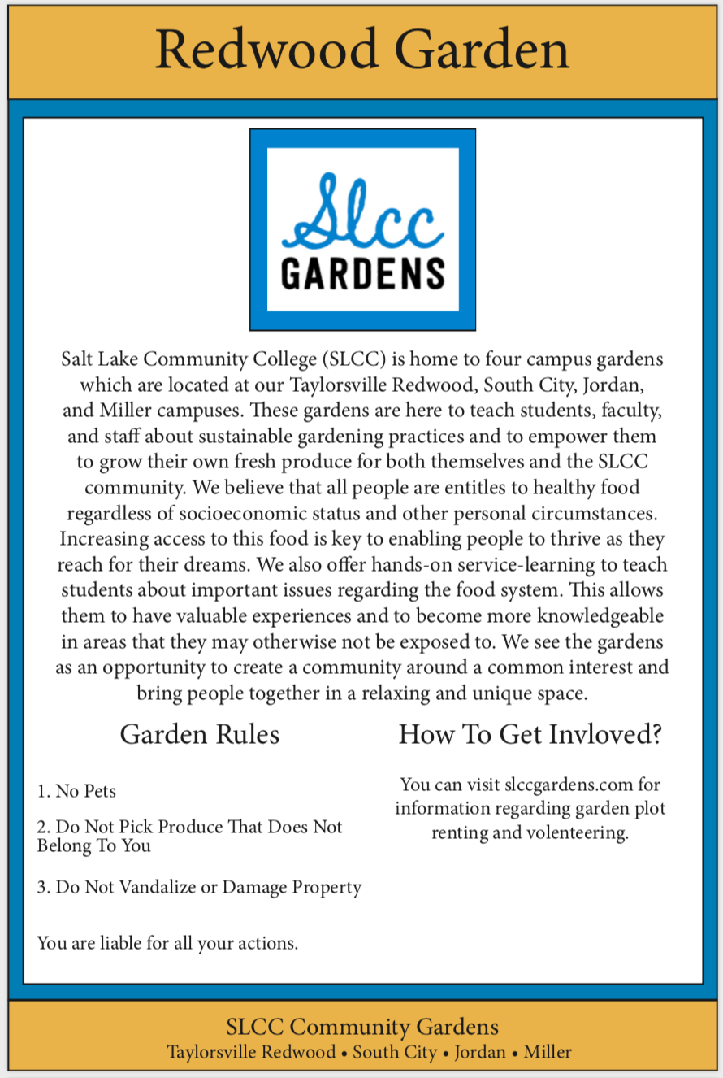

Slide 14
But in the end…
Mostly created what I had asked for
Followed the process well towards the end
Presented well
Perhaps on par with classmates

Slide 15
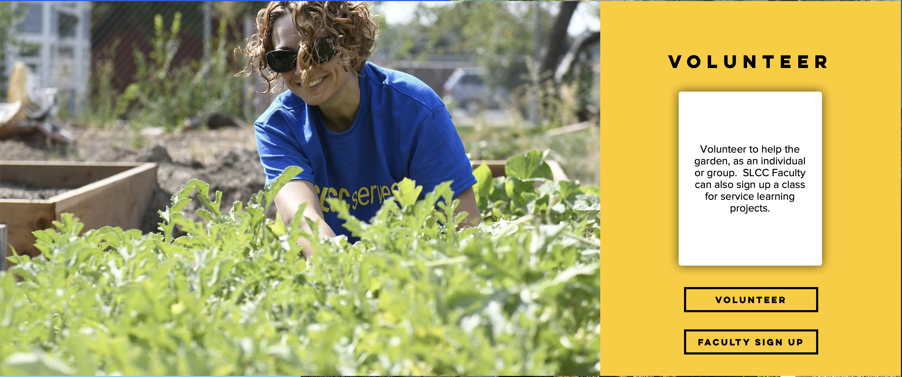
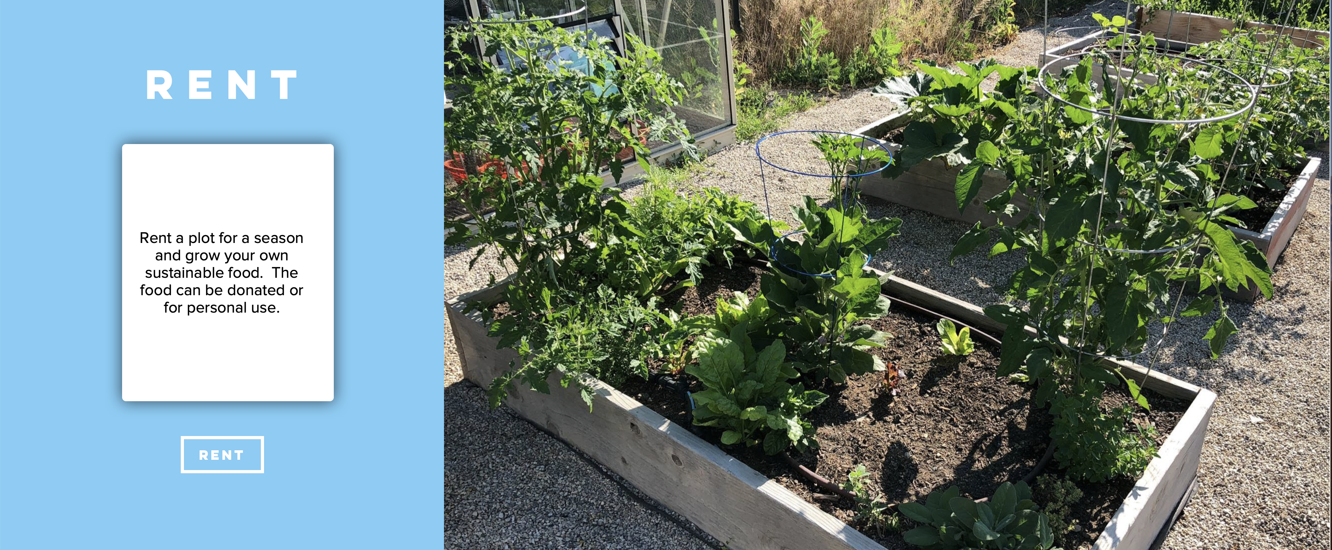
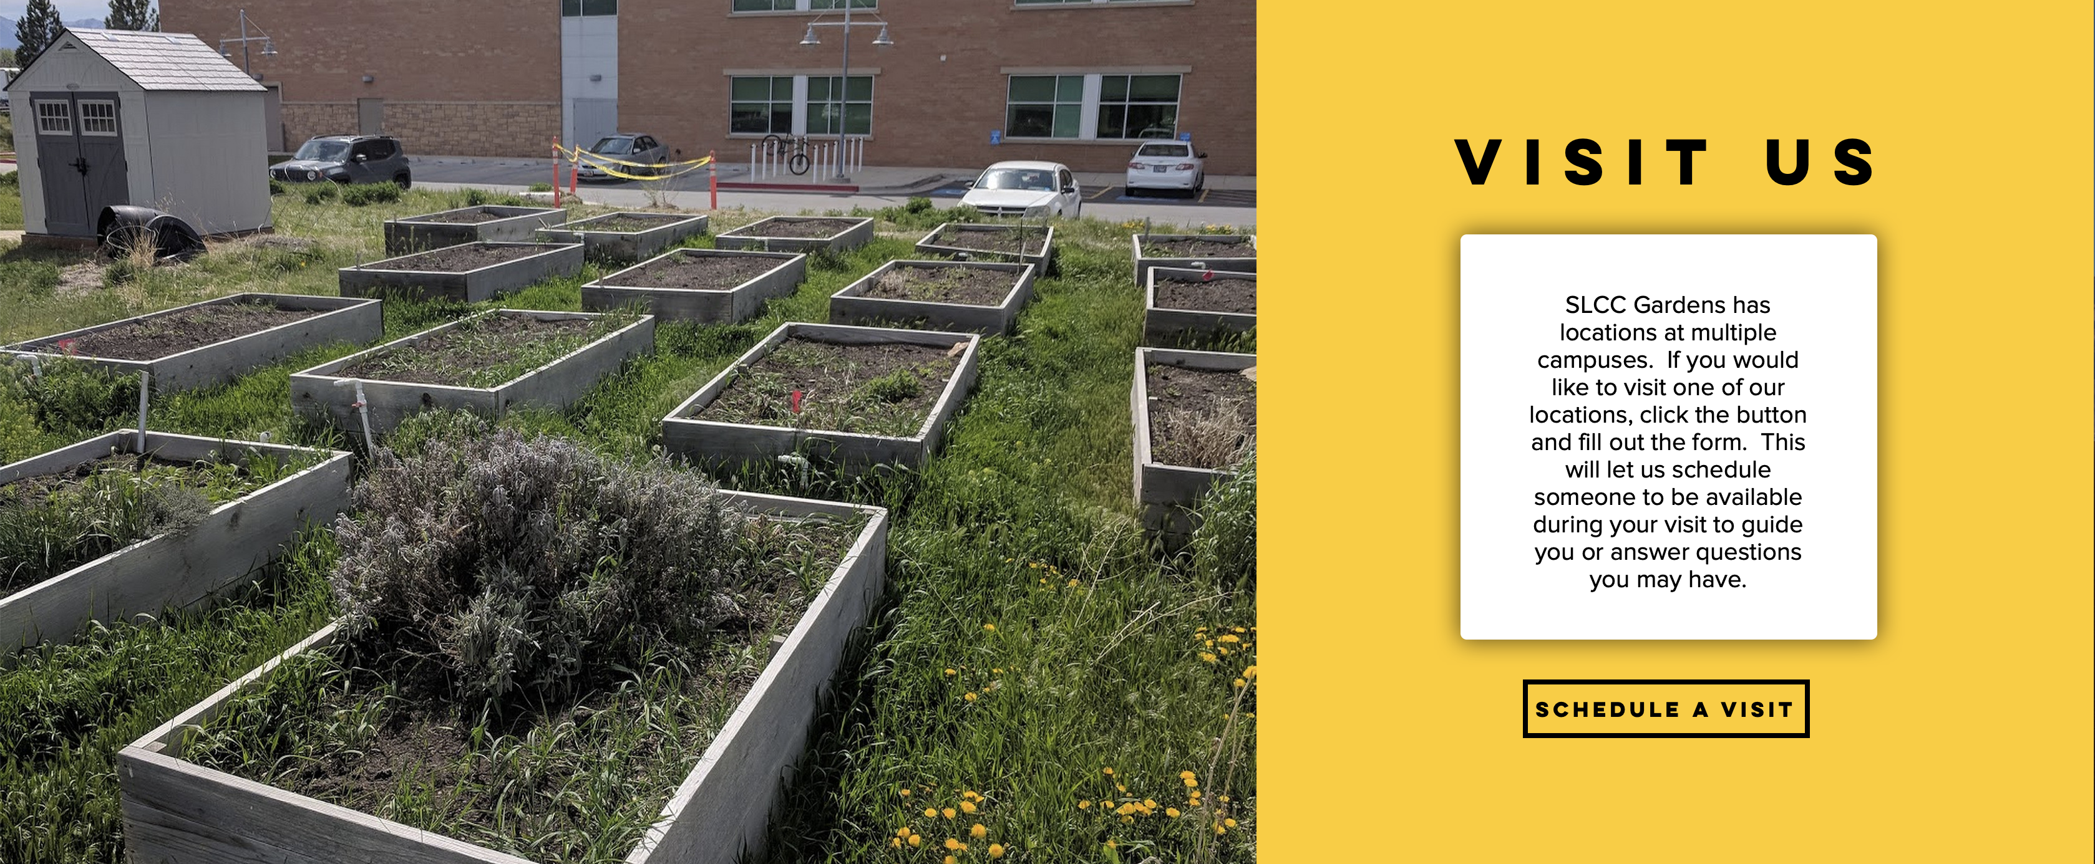

Slide 16
Faculty Outreach

Slide 17
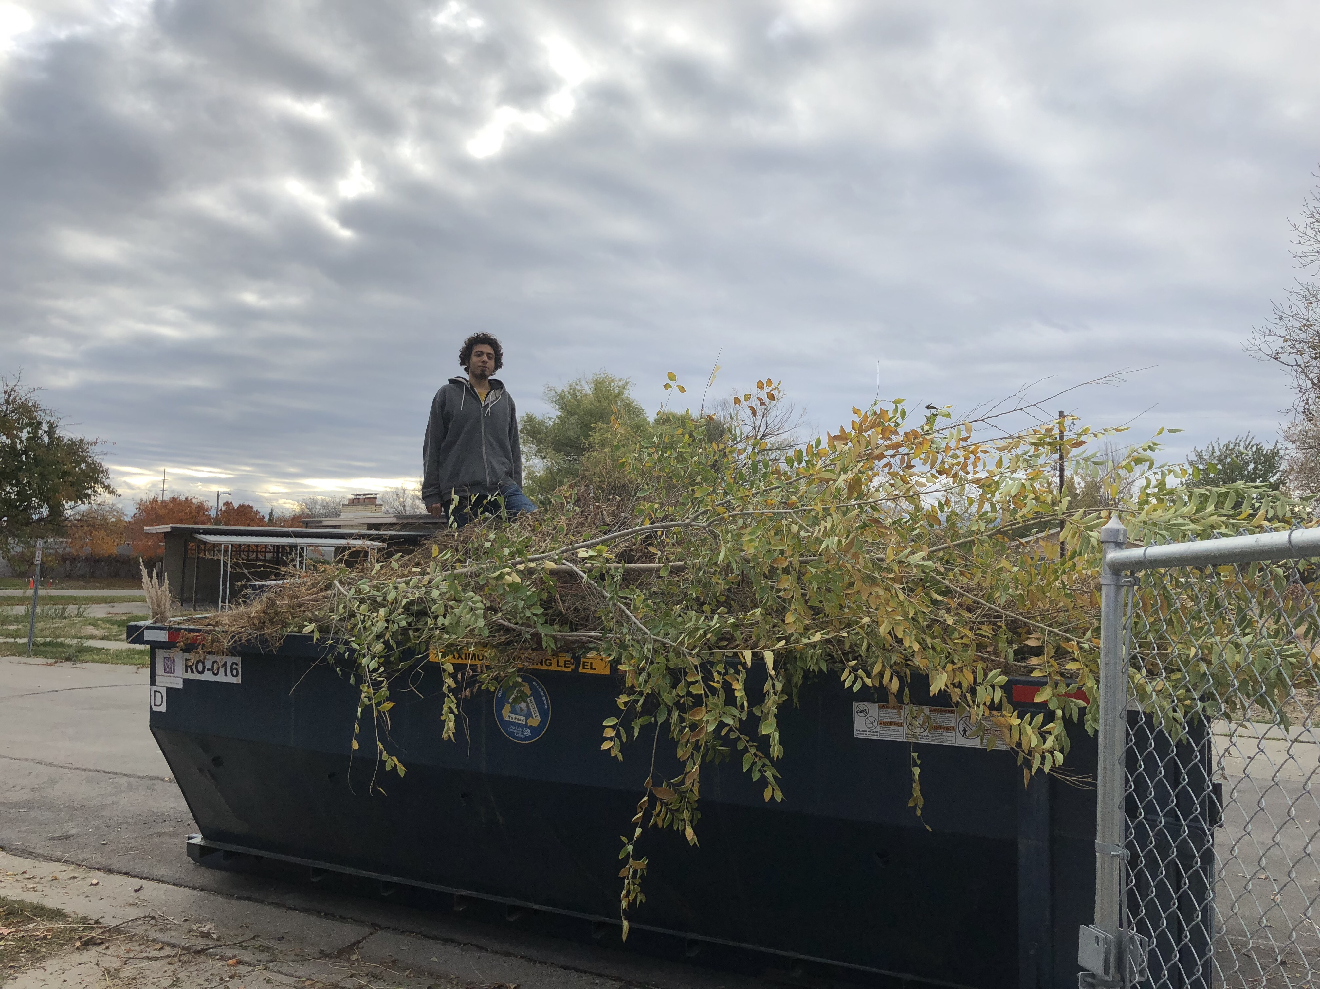
The End

